Slide 1
Predicting Behavior with Logistic Regression – Option 1
Austin Brown
Colorado State University
MIS470: Data Science Foundations
Dr. Alin Tomoiaga
8/22/2021

Slide 2
Problem Statement
This week’s assignment investigates how we apply logistic regressions to make categorical predictions in the real world. We have been posed a scenario in which we are to observe and analyze the “Churn” rate of customers from provided dataset and case study. This data contains multiple variables, not all of which are statistically significant in determining the y output in a regression model.
As the problem requires us to determine a percentage churn rate between 0 and 1, with the ability to later categorize a customer as ‘Churned’ or ‘Retained’, we are required to use a Logistic model to achieve the desired results.

Slide 3
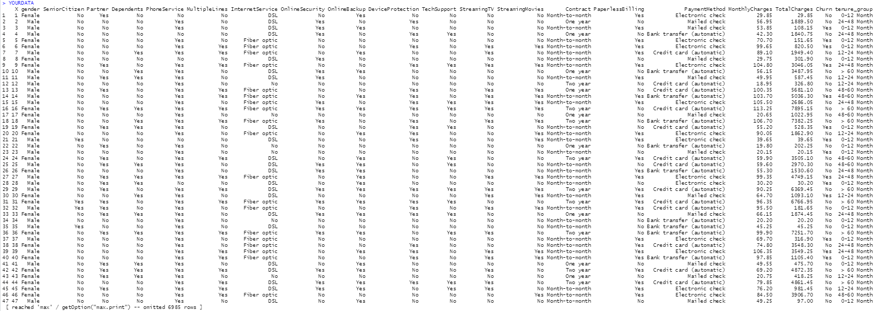
Data
Multiple variables exist within the data set for us to build our model with. Given that we are attempting to predict our Churn rate, that will be our selected y (dependent) variable. Further analysis is needed to determine the proper inclusion of independent variables.

Slide 4
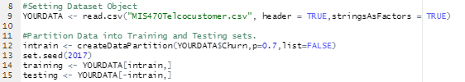
Data Partitioning
In the first part of this task, we partitioned the data between the training and testing set within the provided CSV file provided, aliased as ‘YOURDATA’. This is done in an effort increase stability within the model as well as increase computational efficiency following the establishment of input/output mapping.
As we can see above, we establish the percentage split into train at 70% of the original YOURDATA dataset:
Ex. (intrain <- createDataPartition(YOURDATA$Churn,p=0.7,list=FALSE).

Slide 5
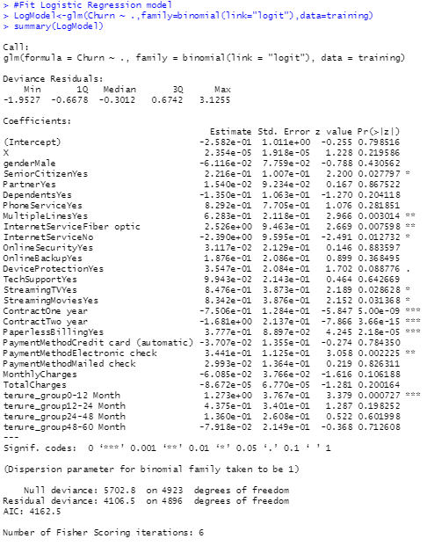
Training Model Fit
After the data is partitioned between test and train, we can use the train set to fit a Logistical Regression model. By running a summary on that model with R we can observe the impact of all independent variables, including the intercept, on the dependent variable. R’s output will be used in the construction of an actual Logistical Regression model based on statistical significance and coefficients.
Based on the outputs, the statistically significant variables relative to predicting Churn are as follows:
- Senior Citizen (Yes)
- Multiple Lines (Yes)
- Internet Service (Fiber Optic)
- Internet Service (No)
- Streaming TV (Yes)
- Streaming Movies (Yes)
- Contract (One Year)
- Contract (Two Year)
- Paperless Billing (Yes)
- Payment Method (Electronic Check)
- Tenure Group (0-12 Months)

Slide 6
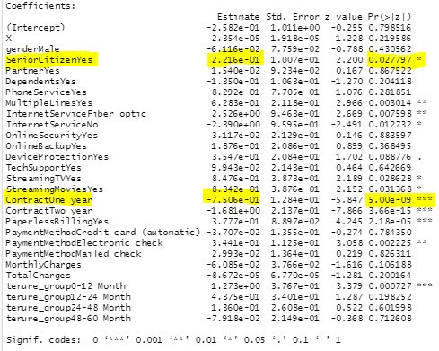
Evaluating the Train Fit – Statistical Significance
Statistically significant output variables result in a p-value, (Pr(>|z|), of less than .05, the standard of statistical significance (alpha = .05). In these cases, we reject the null hypothesis - meaning their sample observed impact on the variation of Churn (y) = (0.0 ≤ y ≤ 1.0) was determined statistically significant or different from the proposed null hypothesis of zero impact.
(Hypothesis Test: H0: b0 = 0 vs H1: b1 != 0).
When we reject the null hypothesis under these circumstances, we are declaring that a less than a 5% chance exists that each of these items do not impact our dependent variable.

Slide 7
Evaluating the Train Fit – Regression Coefficients
Given our list of statistically significant independent variables, we can also look at the coefficient ‘estimate’ in the R output and determine the scale of the impact each variable has on our model. For example, our Senior Citizen (Yes) variable hold a coefficient of 2.216e-01 while our Contract (One Year) sits at -7.506e-01. Based on these values, coupled with the parameters that a Churn = 1 = Churned and Churn = 0 = Not Churned, we can determine that the status of being a Senior Citizen positively effects the Churn rate (results in more churns, as x increases y increases) while One Year Contracts negatively effect the Churn rate (results in less churns, as x increases y decreases).
We can further analyze these numbers by interpreting their relative scale. By viewing the coefficients as a weight for x multiplication, we can easily see that having been a One Year contract customer has 3 times the impact on churn rate relative to being a Senior Citizen. In practice, this means that holding a one year contract has a much greater effect on reducing Churn rate than Senior Citizen designations have on increasing it.

Slide 8
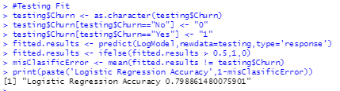
Executing the Test Fit
Now that we have run and analyzed the training data partition, we can run and apply the testing partition within the model. Here we get an accuracy return of .7989 (79.89%) accuracy for the model. This means that when our model predicts a customer churn, it predicts correctly 79.89% of the time.
As you can see from the above scripts, this .7989 accuracy also implies that the model error is equivalent to 1-.7989 (i.e. 1-p) = .2011 = 20.11%. This is a like measurement to a linear regression equations R^2 value that determines the percent representation of variation within the model.

Slide 9
Creating your prediction Model
With the information gather up to this point, it is possible for use to write a valid Logistic Regression Model based on statistically significant variables and their coefficiencts. This model, minus the Error, will account for approximately 80% of the total variation for the prediction of Churn rate. Note that the intercept was not noted as a significant value and has been omitted from the model.
Log( p(y=1) / 1-p(y=1) ) = Logistic Regression Model
Log( p(y=1) / 1-p(y=1) ) = (b + ( b1*x1) + (b2*x2) … = (e^(b+(b1*x1) + (b2*x2))) / (1 + e^(b+(b1*x1) + (b2*x2)))
Probability of y = e^((2.216e-01*(SeniorCitizen-Yes))+(6.283e-01*(MultipleLines-Yes))+(2.526e+00*(InternetService-Fiber optic))+(-2.390e+00*(InternetService-No))+(8.476e-01*(StreamingTV-Yes))+(8.342e-01*(StreamingMovies-Yes))+(-7.506e-01*(Contract-One year))+(-1.681e+00*(Contract-Two year))+(3.777e-01*(Paperless-BillingYes))+(3.441e-01*(PaymentMethod-Electronic check))+(1.273e+00*(tenure_group-0-12 Month))+Error)
By simulating [0,1] values of categorical and numerical floating values for continuous independent variables, it is possible to predict a percentage return against Churn rate, y. In this instance, no statistically significant independent variable is continuous, so all substituted values will adhere to a [0,1] binary input. This will yield a y return where (0.0 ≤ y ≤ 1.0)

Slide 10
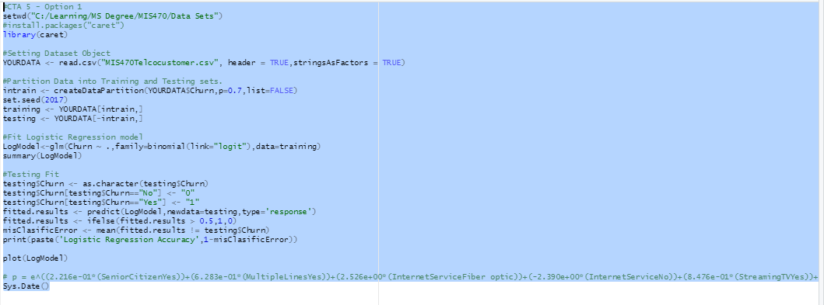
R Inputs and Outputs

Slide 11
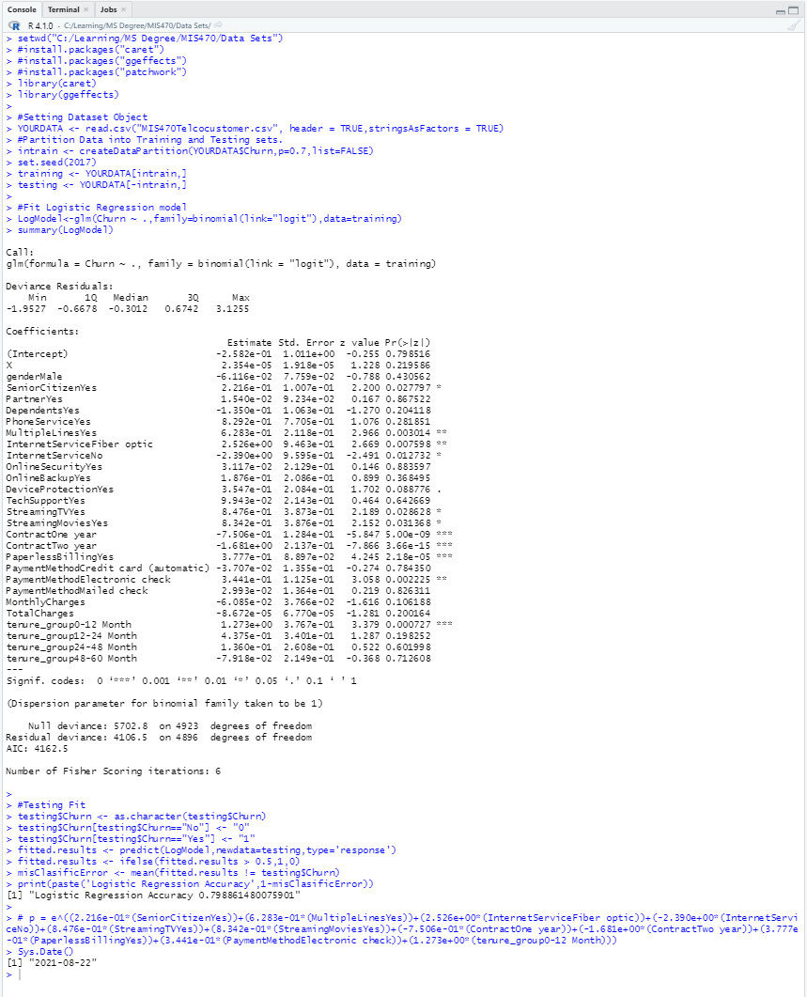
R Inputs and Outputs, Continued

Slide 12
References
Berrier, J., Berrier, H., Chan, C., Nestler, S., Pardoe, I., Sturdivant, R., Vahid, F., Watts, K. (2018). Fundamentals of Data Analytics (R). ZyBook.
Sperandei, S. (2014). Understanding logistic regression analysis. Biochem Med (Zagreb). https://www.ncbi.nlm.nih.gov/pmc/articles/PMC3936971/

